Slide 1
Paper presentation
You have 10 minutes: no outline, 10 slides maximum
The best part is the abstract – it usually contains statement of the problem and conclusions
It is OK if you finish 1-2 minutes early, please try to not go over time limit
Please bring your talk to class in PDF or PPT format on a USB stick, or you can present from your laptop (USB-C or HDMI)
Don’t try to describe everything, describe the key point or key algorithm in the paper
You will get full credit for presenting

Slide 2
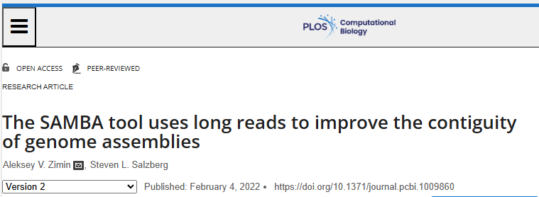
The SAMBA tool uses long reads to improve the contiguity of genome assemblies

Slide 3
Scaffolding with long reads
SAMBA (Scaffolding Assemblies with Multiple Big Alignments) tool uses long reads to re-scaffold contigs from an existing genome assembly and to fill gaps in those scaffolds
The tool is designed to use 10-30x coverage in long read data with a set of existing contigs, although it can function with lower or higher coverage as well.
Open-source, available on github, included into MaSuRCA genome assembly package

Slide 4
The SAMBA algorithm: links
Align reads to the contigs with minimap2
Use reads that align to two different contigs in such a way that they can be joined to generate links between contigs:
  Sum of overhangs<500bp (default) on each side
  Overlap > 2500bp on each side
  Mode than one read required to suggest a merge between two contigs, implied gap size must be consistent
Overhang
Long read
Overlap
Overlap
Contig 1
Contig 2
Overhang

Slide 5
The SAMBA algorithm: links
The set of links yields the graph of contigs:
Contig1 Contig2 gap orientation
Contig1 Contig3 gap orientation
Contig2 Contig3 gap orientation
…
Overhang
Long read
Overlap
Overlap
Contig 1
Contig 2
Overhang

Slide 6
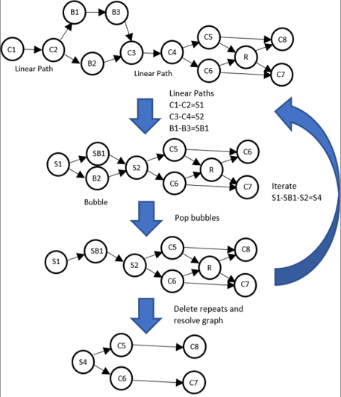
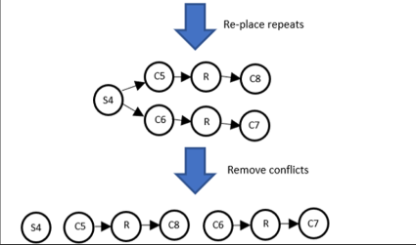
The SAMBA algorithm: Graph of contigs
Resolve three features:
1. Linear paths
2. Bubbles
3. Short repeats

Slide 7
The SAMBA algorithm: Consensus
Long reads
Contig 1
Contig 2 (repeat)
Contig 3

Slide 8
The SAMBA algorithm: Consensus
Create a “patch”
Contig 1
Contig 2 (repeat)
Contig 3

Slide 9
The SAMBA algorithm: Consensus
Merge
Merged contig

Slide 10
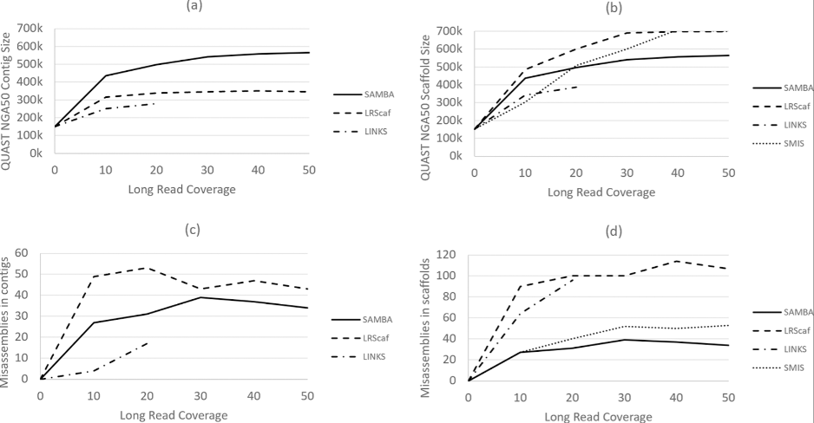
Result: Arabidopsis thaliana assembly, PacBio reads
Longer contigs, fewer errors compared to LRScaf, SMIS and LINKS

Slide 11
Summary
SAMBA is an effective tool aimed at improving contiguity of existing genome assemblies with long reads
No need to re-assemble, useful in cases where original data is no longer available
Can use both PacBio and Oxford nanopore long reads

Slide 12
Lab #6: Training and scoring with
PWM and WAM
Lab #6: Due Friday November 21st at 8:00pm. In this lab assignment you will implement training and scoring with Positional Weight and Weight Array (graduate only) matrices. Submit through GradeScope’s autograder.
Data: training https://github.com/alekseyzimin/BME-Algorithms-for-Analysis-of-Genomic-Data/raw/refs/heads/main/training.txt testing https://github.com/alekseyzimin/BME-Algorithms-for-Analysis-of-Genomic-Data/raw/refs/heads/main/testing20.txt. When computing logs of probabilities, add 1e-16 to the probability to avoid getting log(0)
The assignment is to write the following functions in python and submit them through autograder in train_score_pwm.py file:
  (G:10pts,U:10pts) load_sequences(file) : reads strings from file, one string per line, returns array of strings
  (G:25pts,U:50pts) compute_pwm(sequences) : computes positional weights from training data in the array of strings sequences, returns dictionary of positional weights pwm[base][position]=weight; base is “ACGT”, position is from 0 to len(sequences[0])-1
  (G:20pts,U:40pts) score_pwm(sequences,pwm) : returns array of numerical positional weight scores for array of DNA sequences sequences and positional weight matrix (dictionary) pwm
Graduate students only:
  (G:25pts) compute_wam(sequences) : computes Weight Array Matrix from training data in the array of strings sequences, returns dictionary of weights wam[tuple][position]=weight; tuple is “AA, “AC”,...,”TT”, position is from 0 to len(sequences[0])-2
  (G:20pts) score_wam(sequences,pwm,wam) : returns array of numerical Weight Array scores for array of DNA sequences sequences, positional weight matrix (dictionary) pwm, and weight array matrix (dictionary) wam

Slide 13
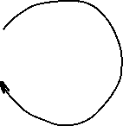
Viterbi algorithm for HMMs
Start
0.5
0.5
C
A 0.2
C 0.3
G 0.3
T 0.2
N
A 0.3
C 0.2
G 0.2
T 0.3
0.5
0.5
0.6
0.4
Let's consider the following simple HMM for coding/non-coding regions of DNA. This model is composed of 2 states, C (coding) and N (non-coding).

Slide 14
Viterbi algorithm for HMMs
Start
0.5
0.5
C
A 0.2
C 0.3
G 0.3
T 0.2
N
A 0.3
C 0.2
G 0.2
T 0.3
0.5
0.5
0.6
0.4
Consider the sequence S = GGCACTGAA
There are several paths through hidden states (C and N) that lead to this sequence, e.g. NNCCCCNNN
Prob(S) through this path is 0.5*0.2*0.6*0.2*0.4*0.3*...

Slide 15
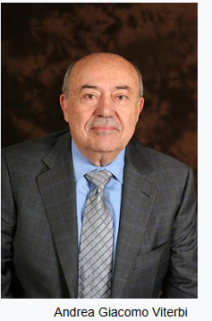
Viterbi algorithm for HMMs
Start
0.5
0.5
C
A 0.2
C 0.3
G 0.3
T 0.2
N
A 0.3
C 0.2
G 0.2
T 0.3
0.5
0.5
0.6
0.4
Andrew James Viterbi
Image credit: Wikipedia
Consider the sequence S = GGCACTGAA
There are several paths through hidden states (C and N) that lead to this sequence, but they do not have the same probability
The Viterbi algorithm allows us to compute the most probable (best) path

Slide 16
Viterbi algorithm for HMMs
Start
Consider the sequence S = GGCACTGAA
The probability of the best
path ending in state l
with observation i is:
0.5
0.5
C
A 0.2
C 0.3
G 0.3
T 0.2
N
A 0.3
C 0.2
G 0.2
T 0.3
0.5
0.5
0.6
0.4
$$p_{l}\left(i,x\right)=e_{l}\left(i\right)\max_{k=(N,C)}{(}p_{k}\left(j,x−1\right)∗p_{kl})$$
Probability to observe element i in state l
Probability of the best path ending at position x-1 in state k with element j
Probability of transition from state k to state l

Slide 17
Viterbi algorithm for HMMs
Start
Consider the sequence S = GGCACTGAA
The probability of the best
path ending in state l
with observation i is:
In our example, the probability of the best path ending in state l=C with “A” at the 4th position is:
0.5
0.5
C
A 0.2
C 0.3
G 0.3
T 0.2
N
A 0.3
C 0.2
G 0.2
T 0.3
0.5
0.5
0.6
0.4
$$p_{l}\left(i,x\right)=e_{l}\left(i\right)\max_{k=(N,C)}{(}p_{k}\left(j,x−1\right)∗p_{kl})$$
$$p_{C}\left(A,4\right)=e_{C}\left(A\right)\max_{k}{(}p_{N}\left(C,3\right)∗p_{NC},p_{C}\left(C,3\right)∗p_{CC})$$

Slide 18
Viterbi algorithm for HMMs
For simplicity, let’s convert
everything to log₂(p):
Start
0.5
0.5
C
A 0.2
C 0.3
G 0.3
T 0.2
N
A 0.3
C 0.2
G 0.2
T 0.3
0.5
0.5
0.6
0.4

Slide 19
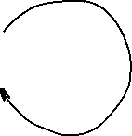
Viterbi algorithm for HMMs
For simplicity, let’s convert
everything to log₂(p):
This allows us to add
probabilities instead of
multiplying, which is
more efficient and accurate
Start
-1
-1
C
A -2.322
C -1.737
G -1.737
T -2.322
N
A -1.737
C -2.322
G -2.322
T -1.737
-1
-1
-0.737
-1.322

Slide 20
Viterbi algorithm for HMMs
Start
S = GGCACTGAA
Log probability that the first G
was emitted by state C:
Log probability that the first G
was emitted by state N:
-1
-1
C
A -2.322
C -1.737
G -1.737
T -2.322
N
A -1.737
C -2.322
G -2.322
T -1.737
-1
-1
-0.737
$$p_{C}\left(G,1\right)=−1−1.737=−2.737$$
-1.322
$$p_{N}\left(G,1\right)=−1−2.322=−3.322$$

Slide 21
Viterbi algorithm for HMMs
Start
S = GGCACTGAA
Log probability that the second G
was emitted by state C:
Log probability that the second G
was emitted by state N:
-1
-1
C
A -2.322
C -1.737
G -1.737
T -2.322
N
A -1.737
C -2.322
G -2.322
T -1.737
-1
-1
-0.737
-1.322
$$p_{C}\left(G,2\right)=−1.737+\max\left(p_{C}\left(G,1\right)+p_{CC},p_{N}\left(G,1\right)+p_{NC}\right)=−5.474$$
$$p_{N}\left(G,2\right)=−2.322+\max\left(p_{C}\left(G,1\right)+p_{CN},p_{N}\left(G,1\right)+p_{NN}\right)=−6.059$$

Slide 22
Viterbi algorithm for HMMs
Start
S = GGCACTGAA
Log probability that the second G
was emitted by state C:
Log probability that the second G
was emitted by state N:
-1
-1
C
A -2.322
C -1.737
G -1.737
T -2.322
N
A -1.737
C -2.322
G -2.322
T -1.737
-1
-1
-0.737
-1.322
$$p_{C}\left(G,2\right)=−1.737+\max\left(p_{C}\left(G,1\right)+p_{CC},p_{N}\left(G,1\right)+p_{NC}\right)=−5.474$$
-2.737-1
-3.322-1.322
$$p_{N}\left(G,2\right)=−2.322+\max\left(p_{C}\left(G,1\right)+p_{CN},p_{N}\left(G,1\right)+p_{NN}\right)=−6.059$$
-2.737-1
-3.322-0.737

Slide 23
Viterbi algorithm for HMMs
Start
S = GGCACTGAA
Log probability that the second G
was emitted by state C:
Log probability that the second G
was emitted by state N:
-1
-1
C
A -2.322
C -1.737
G -1.737
T -2.322
N
A -1.737
C -2.322
G -2.322
T -1.737
-1
-1
-0.737
-1.322
$$p_{C}\left(G,2\right)=−1.737+\max\left(p_{C}\left(G,1\right)+p_{CC},p_{N}\left(G,1\right)+p_{NC}\right)=−5.474$$
-2.737-1
-3.322-1.322
$$p_{N}\left(G,2\right)=−2.322+\max\left(p_{C}\left(G,1\right)+p_{CN},p_{N}\left(G,1\right)+p_{NN}\right)=−6.059$$
-2.737-1
-3.322-0.737

Slide 24
Viterbi algorithm for HMMs
Start
S = GGCACTGAA
Iteratively compute probabilities, record values and where you came from in two matrices (arrays):
-1
-1
C
A -2.322
C -1.737
G -1.737
T -2.322
N
A -1.737
C -2.322
G -2.322
T -1.737
-1
-1
-0.737
-1.322
 | G | G | C | A | C | T | G | A | A
C | -2.73 | -5.47 | -8.21 | -11.53 | -14.01 | ... |  |  | -25.65
N | -3.32 | -6.06 | -8.79 | -10.94 | -14.01 | ... |  |  | -24.49

Slide 25
Viterbi algorithm for HMMs
Start
S = GGCACTGAA
Backtrack:
-1
-1
C
A -2.322
C -1.737
G -1.737
T -2.322
N
A -1.737
C -2.322
G -2.322
T -1.737
-1
-1
-0.737
-1.322
 | G | G | C | A | C | T | G | A | A
C | -2.73 | -5.47 | -8.21 | -11.53 | -14.01 | ... |  |  | -25.65
N | -3.32 | -6.06 | -8.79 | -10.94 | -14.01 | ... |  |  | -24.49

Slide 26
Viterbi algorithm for HMMs
Start
S = GGCACTGAA
Backtrack:
The most probable path is: CCCNNNNNN, its probability is 2^{-24.49}
-1
-1
C
A -2.322
C -1.737
G -1.737
T -2.322
N
A -1.737
C -2.322
G -2.322
T -1.737
-1
-1
-0.737
-1.322
 | G | G | C | A | C | T | G | A | A
C | -2.73 | -5.47 | -8.21 | -11.53 | -14.01 | ... |  |  | -25.65
N | -3.32 | -6.06 | -8.79 | -10.94 | -14.01 | ... |  |  | -24.49

Slide 27
The Viterbi algorithm: summary
The Viterbi algorithm is used to compute the most probable path (as well as its probability). It requires knowledge of the parameters of the HMM model and a particular output sequence and it finds the state sequence that is most likely to have generated that output sequence.
It works by finding a maximum over all possible state sequences.
In sequence analysis, this method can be used for example to predict coding vs non-­coding sequences.
Similar (in spirit) to Smith-Waterman alignment!

